Slide 1
McStas Union components
Mads Bertelsen, ESS DMSC

Slide 2
Session overview
Introduction of concentric keyword for sample environment simulation
Introduction to the Union components for advanced sample environment simulation
Exercise where you build sample environment
Talk on understanding of Union results and showcase of possibilities
Exercise on adding loggers to your sample environment
Last talk with showcase on full instrument simulation

Slide 3
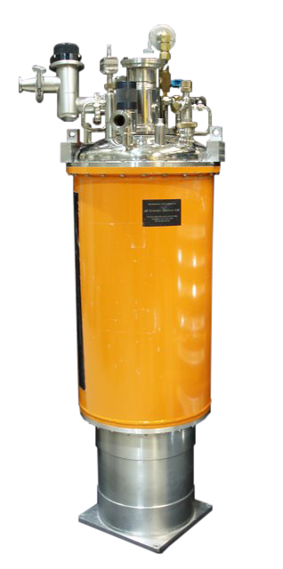
Multiple scattering
Multiple scattering can happen in all systems
Adding several materials complicates matters
In spatially large systems time of flight is affected by multiple scattering

Slide 4
Multiple scattering
q₂
k_{f}
q
k_{i}
q₁
Multiple scattering can happen in all systems
Adding several materials complicates matters
In spatially large systems time of flight is affected by multiple scattering
k_{f}
q₂
q
k_{i}
q₁
k_{f}
q₂
q
k_{i}
q₁

Slide 5


Concentric keyword in McStas
Simple sample container
Available in PowderN and Isotropic_sqw
COMPONENT a = Container_1(concentric=1, …) AT (0,0,0) RELATIVE sample_position
COMPONENT b = Sample(…) AT (0,0,0) RELATIVE sample_positon
COMPONENT c = Container_2(concentric=0,…) AT (0,0,0) RELATIVE Container_1

Slide 6
Concentric keyword in McStas
Sample environment
Available in PowderN and Isotropic_sqw
COMPONENT a = Container_1(concentric=1, …) AT (0,0,0) RELATIVE sample_position
COMPONENT b = Sample(…) AT (0,0,0) RELATIVE sample_positon
COMPONENT c = Container_2(concentric=0,…) AT (0,0,0) RELATIVE Container_1

Slide 7
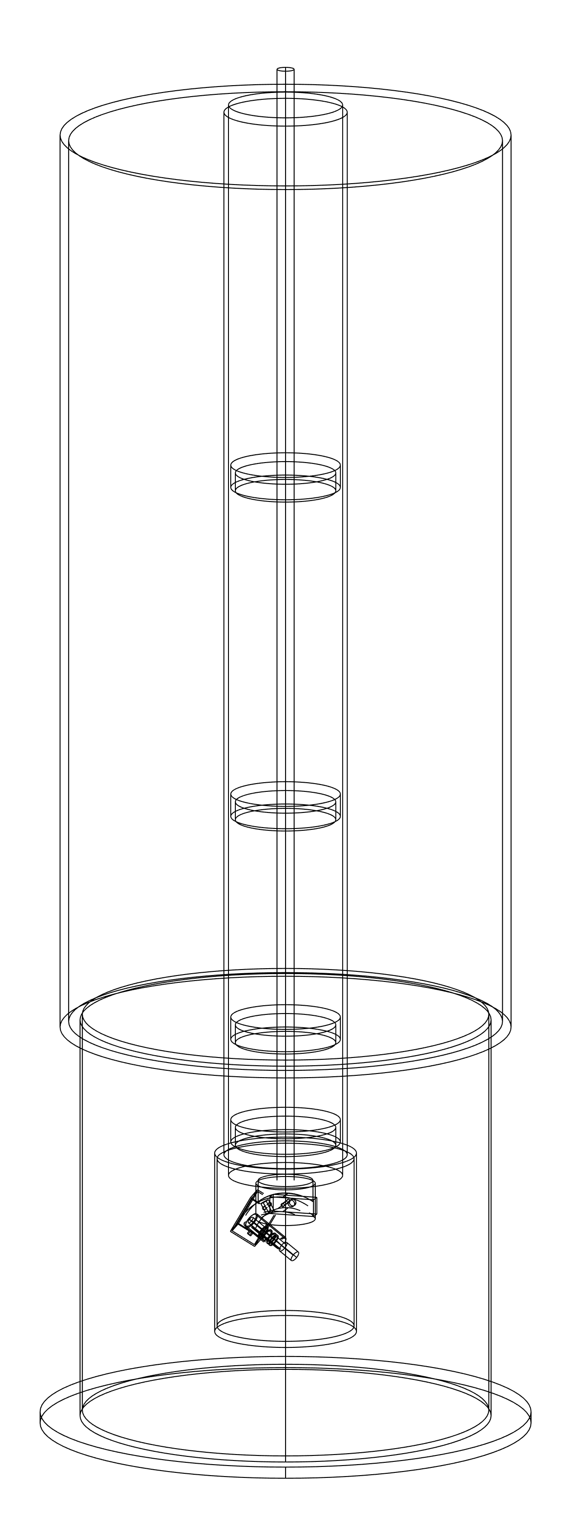
Union introduction
Modular geometry and physics
Aims to simulate complex systems
All trajectories allowed

Slide 8
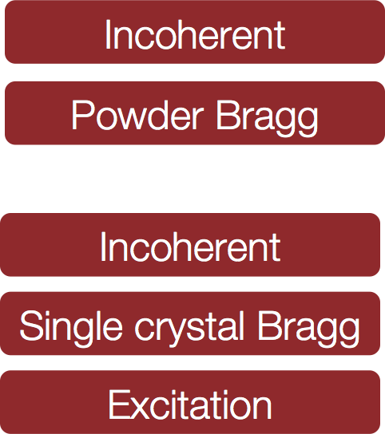
Union overview
Geometry
Materials
Processes

Slide 9
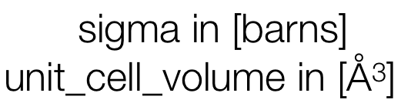

Union process syntax
COMPONENT Al_incoherent = Incoherent_process( sigma=4*0.0082,packing_factor=1, unit_cell_volume=66.4) AT (0,0,0) ABSOLUTE
COMPONENT Al_powder = Powder_process( reflections="Al.laz") AT (0,0,0) ABSOLUTE
COMPONENT Al = Union_make_material( my_absorption=100*4*0.231/66.4, process_string=“Al_incoherent,Al_powder”) AT (0,0,0) ABSOLUTE
my [1/m] = cross section per unit cell / unit cell volume

Slide 10
Union concepts: Priority
Aluminium priority = 8.2
Priority to handle overlapping geometries
The highest priority is simulated in regions where more are overlapping
Vanadium priority = 5.1

Slide 11
Union concepts: Priority
Priority to handle overlapping geometries
The highest priority is simulated in regions where more are overlapping

Slide 12
Union concepts: Priority
Priority to handle overlapping geometries
The highest priority is simulated in regions where more are overlapping
Problem: Sides can not be tangennts

Slide 13
Union concepts: Priority
Priority to handle overlapping geometries
The highest priority is simulated in regions where more are overlapping
Problem: Sides can not be tangennts
Solution: A few micrometers is plenty

Slide 14
Union geometry syntax
cryostat_shell priority = 10
COMPONENT cryostat_shell = Union_cylinder( radius=0.15,height=0.4, priority=10,material_string="Al") AT (0,0,0) RELATIVE target ROTATED (0,0,0) RELATIVE target
COMPONENT cryostat_vacuum = Union_cylinder( radius=0.147,height=0.39, priority=11,material_string="Vacuum") AT (0,0,0) RELATIVE target ROTATED (0,0,0) RELATIVE target
cryostat_shell priority = 10
cryostat_shell priority = 11

Slide 15
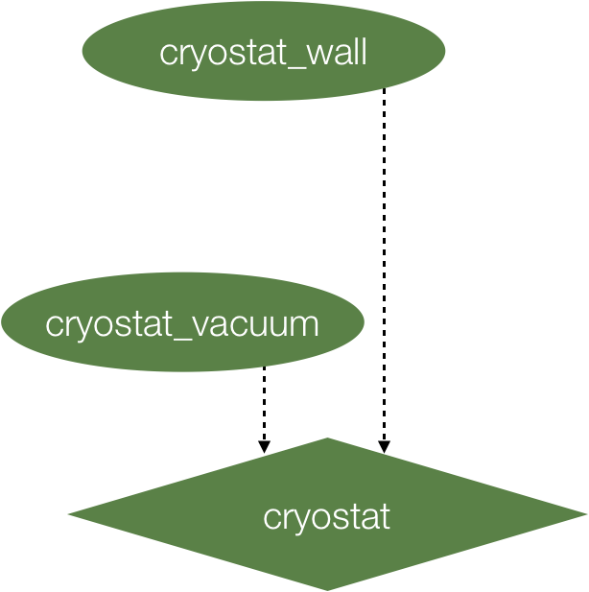
Union geometry syntax
COMPONENT cryostat_shell = Union_cylinder( radius=0.15,height=0.4, priority=10,material_string="Al") AT (0,0,0) RELATIVE target ROTATED (0,0,0) RELATIVE target
COMPONENT cryostat_vacuum = Union_cylinder( radius=0.147,height=0.39, priority=11,material_string="Vacuum") AT (0,0,0) RELATIVE target ROTATED (0,0,0) RELATIVE target
COMPONENT cryostat = Union_master() AT (0,0,0) RELATIVE target ROTATED (0,0,0) RELATIVE target

Slide 16
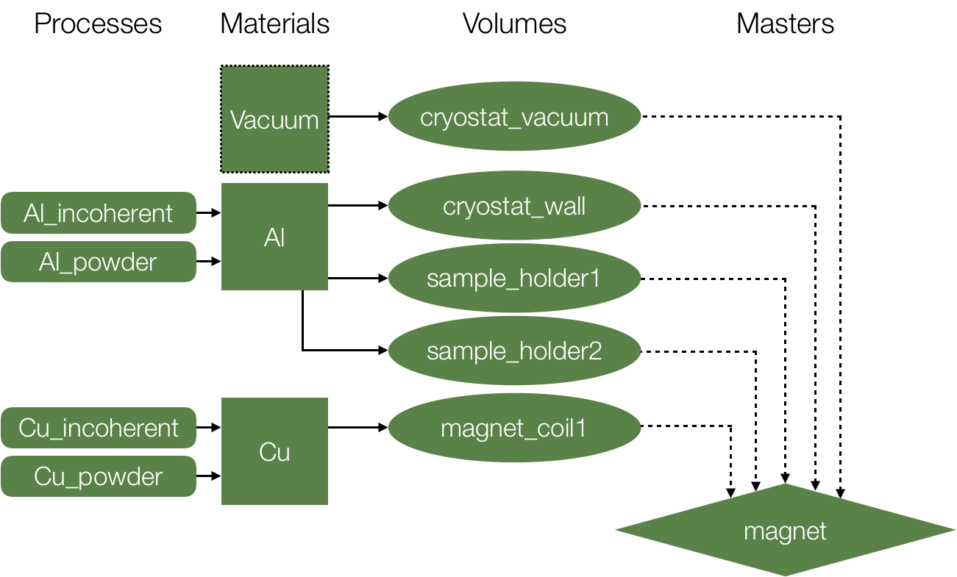
Union components working together

Slide 17
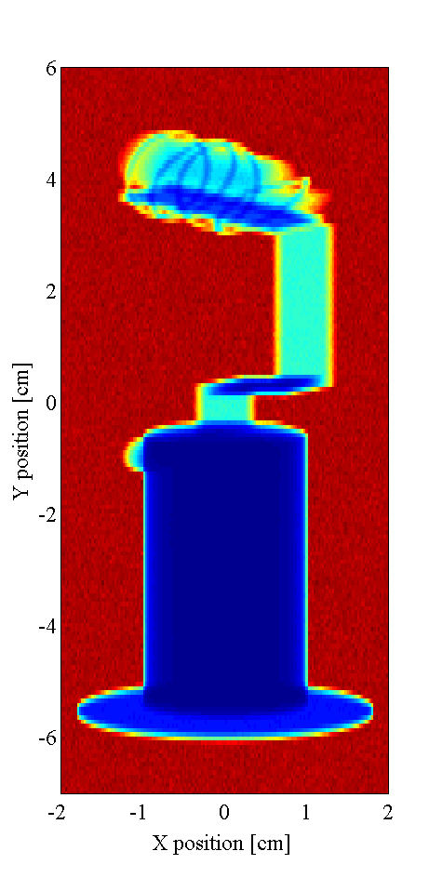
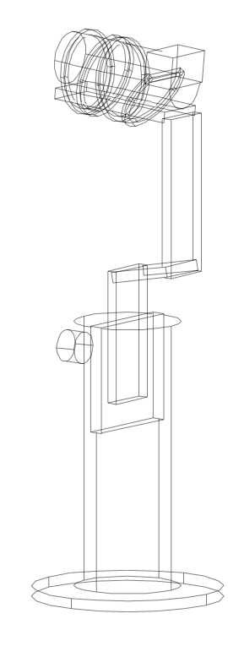
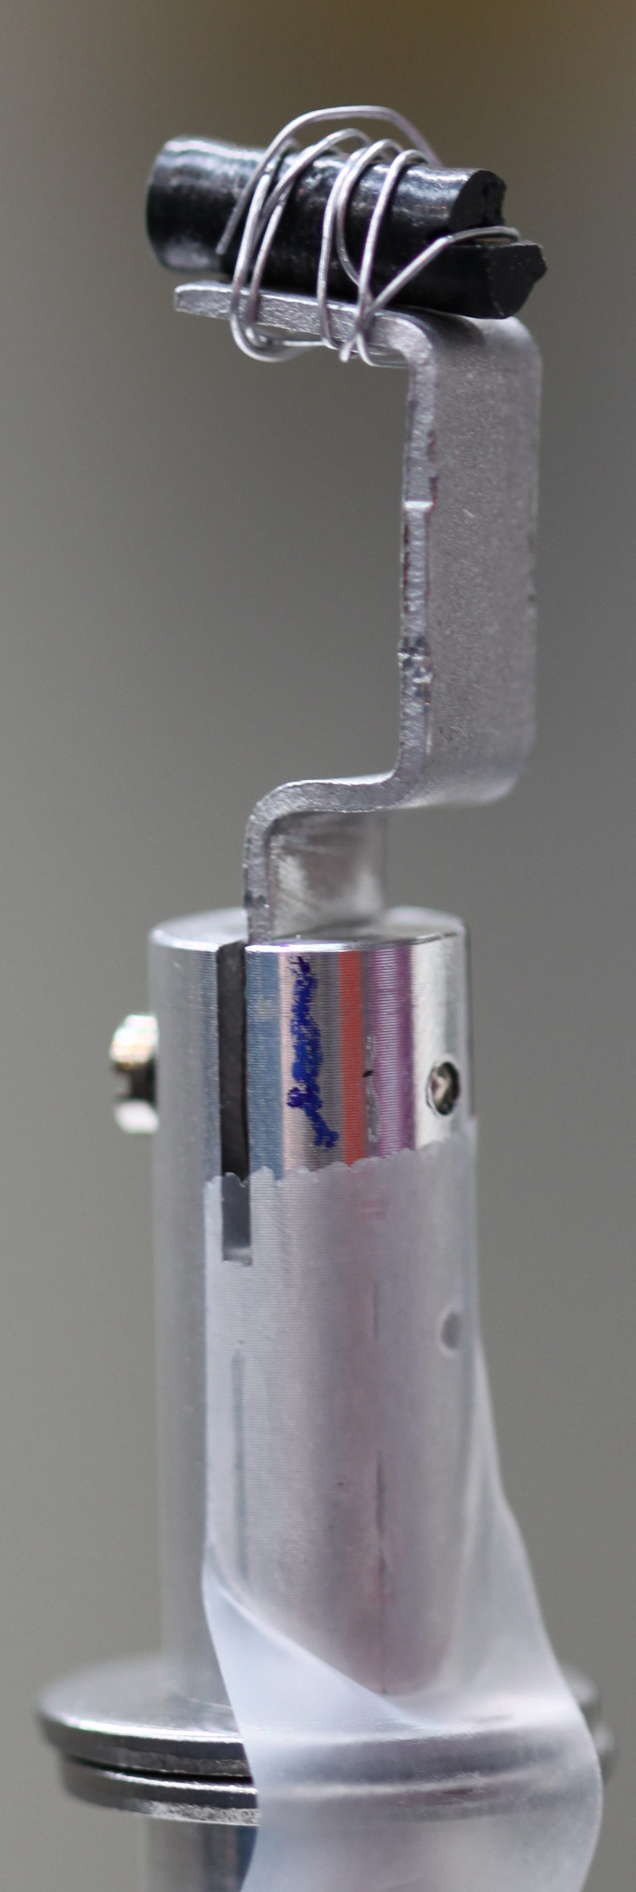
What can you make?
Easy assembly of complex geometries
Rich materials for each geometry
Photo by Pia Ray Jensen

Slide 18
Exercise
open_exercise.instr contains material definitions, source, Union sample and monitors
Expand to include some sample environment!
Exercise text on github with further help
This exercise will continue after the next lecture

